Slide 1
CQRS and Event Sourcing Author : Srinivas Basha

Slide 2
CQRS(Command Query Responsibility Segregation)
CQRS is a software design pattern that stands for Command Query Responsibility Segregation.
CQRS suggests that applications should be divided in a command and a query part. Commands alters the state of an object or entity, and queries return the state of an object or entity.
Instead of having a single interface for read and write operations CQRS is altering and querying of data as 2 separate concerns.
WHY CQRS
CQRS allows us to scale up the command and query sides independently.
Also, for applications, which are used by many users or need to support a lot of parallel operations on the same set of data.

Slide 3
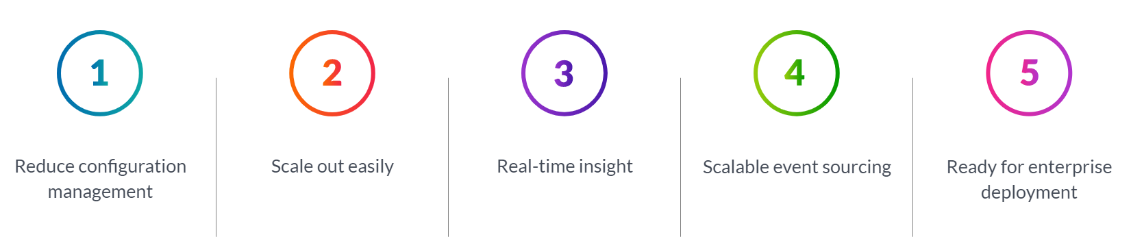
Event Sourcing
Event Sourcing defines an approach where all the changes that are made to object or entity are stored as immutable events to event store , as opposed to storing just the current state.
Why Event Sourcing must be combined with CQRS
What will happen if the query API fails and database records are lost, how will the database be repopulated and updated this is the reason we must combine CQRS with Event sourcing.
If the query API is down and we lost the data in DB and on the other side the events will be safe in event store which will repopulate the records from event store to the database.
How do we maintain event store and maintaining it so difficult these days
The solution is Axon Framework – provides Zero configuration message router and event store for AXON. Below are the benefits of Axon server which is a part of Axon Framework.

Slide 4
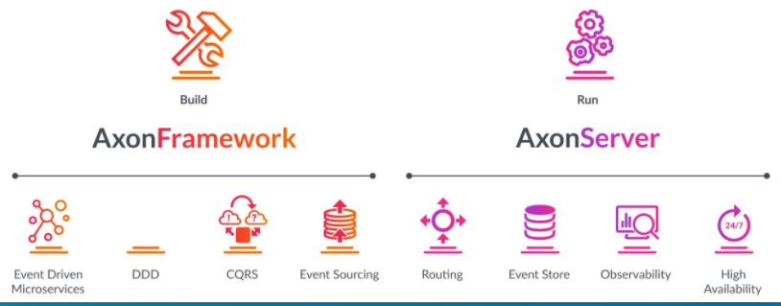
Axon Framework and Axon Server

Slide 5
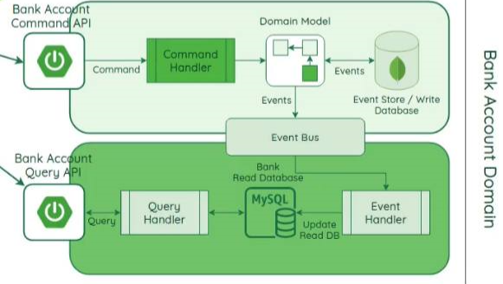
What we are going to build( due to some installation issues in the system, I am using H2 database)

Slide 6


Slide 7


